Slide 1
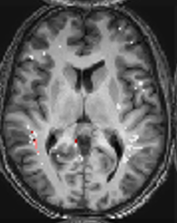
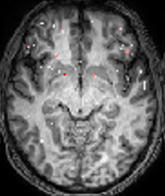
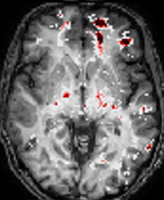
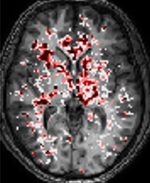





A BBBD maps
2 3 4
1
5
4
3
B Regional Analysis
Z score
2
0
C Whole brain
D Regional analysis
Notes:
Epilepsy 1 – AB_1866LFT
2 - MH 4108 LF
3 - WS_7206 G
Controls
1 – AN 0207
2 – HS 5404

Slide 2
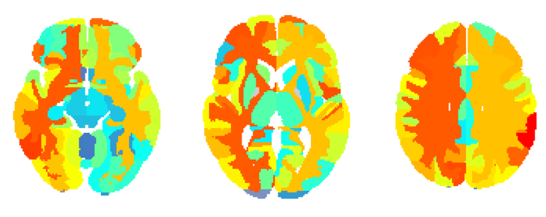
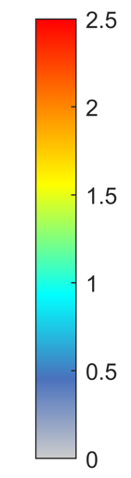
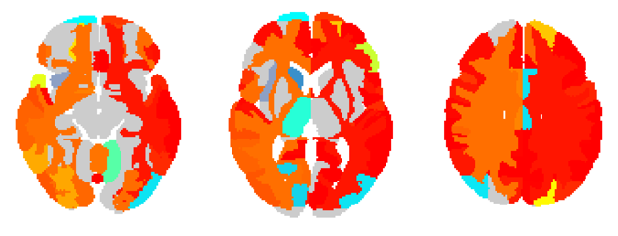
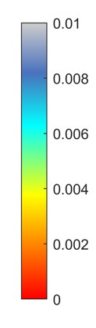
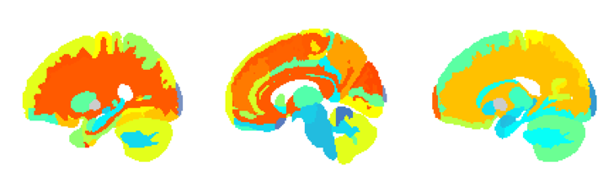
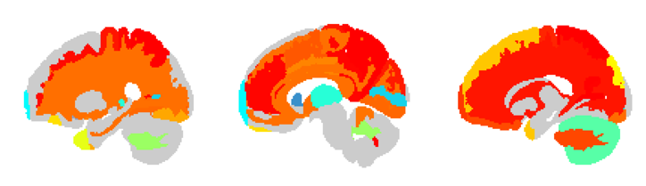
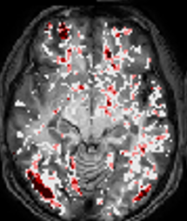

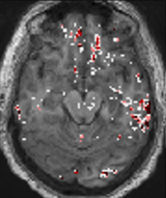

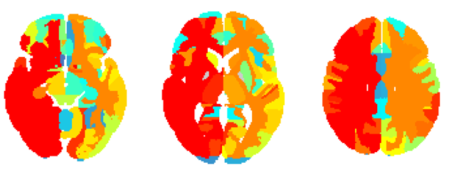
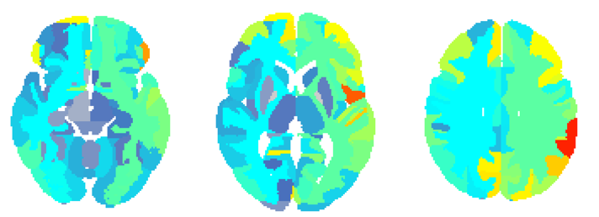
A All PWE vs. controls
B All PWE vs. Controls
^{x}10⁻³
2.5
1
2
8
1.5
6
Z score
P value
1
4
0.5
2
0
0
C Generalized
D Temporal
5
4
3
Z score
2
0
2.5
2
1.5
Zscore
1
0.5
0
E All Patients
F
G Brain regions with BBBD
Notes:
Fig 2
Examples:
EA 0804
LL 0265
BT 3007 – left side
Optional:
AF7084 – linear and tofts diffuse
BA 5372 – linear G and tofts F

Slide 3
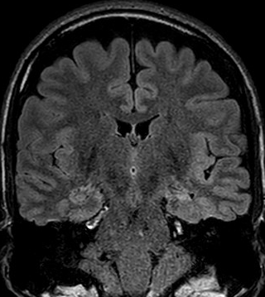
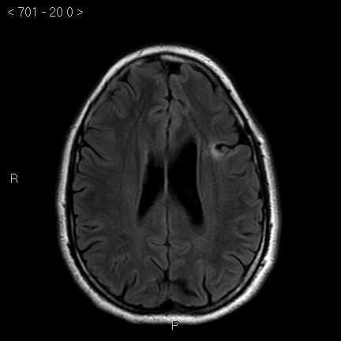
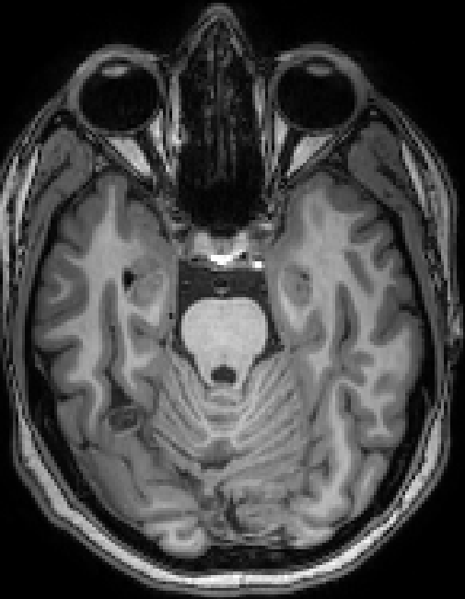
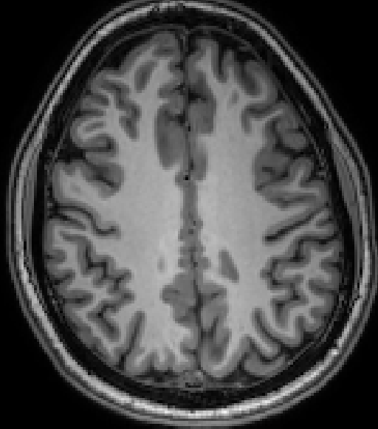
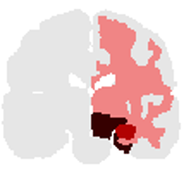



A
B
C
5
4
3
Z score
2
0
D E F
Notes:
Fig 3
A - MH_4108
B - BT_3007
C - RS_7023

Slide 4
A Age
B Gender
C Age of onset
D Years of epilepsy
E Seizure frequency
Notes:
Fig 1S

Slide 5
A
B
C
D
Notes:
Fig 2S

Slide 6
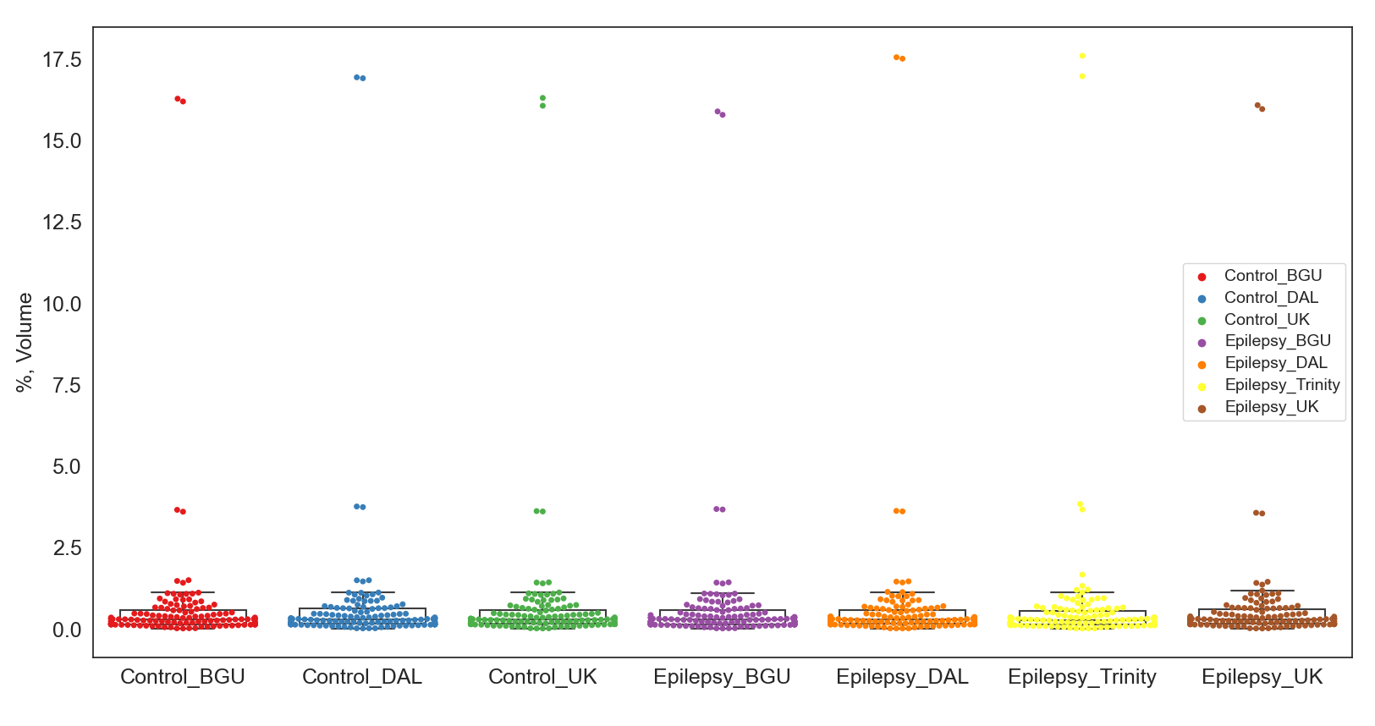
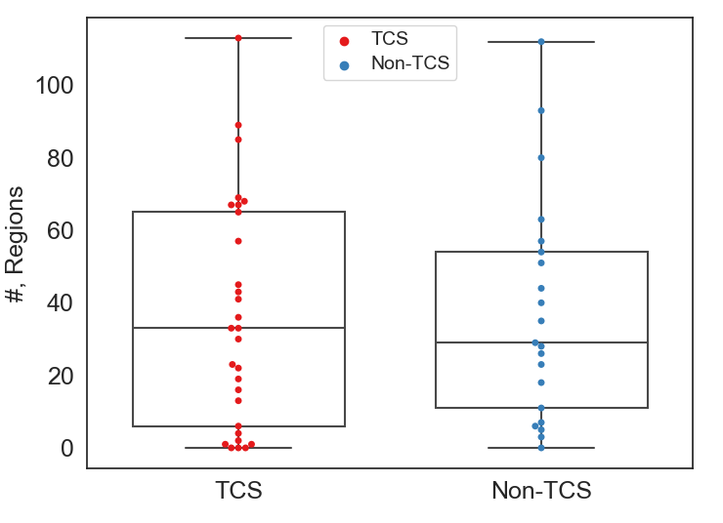
P=0.84

